Slide 1
Predicting NFL Game Outcomes

Slide 2
Outline
Summary
The Data
Performance Models
Cool Graphs
Analysis Details
Stakeholders
Conclusions

Slide 3
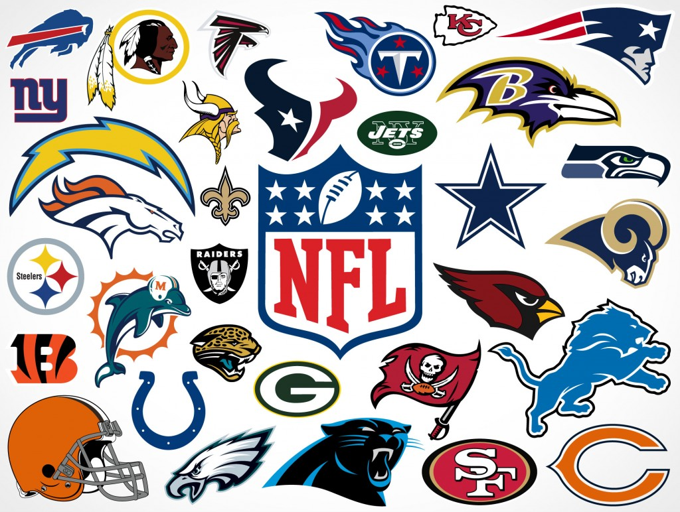
Summary
I would like to have a system that predicts the outcome of the NFL games for the season
I will base my predictions on information about the previous games for each team playing, and target the points difference between the score of the home team and the score of the away team
I will also answer the question “Will the home team win?” based on several factors

Slide 4
The Data
NFL pro football reference game information from years 2000 - 2017
Odds - money line, open/close lines historic info
Kaggle site data - NFL scores and betting data
I merged these 3 files together for my analysis
Raw data available here:
https://www.pro-football-reference.com/years
http://www.aussportsbetting.com/historical data/nfl.xlsx
https://www.kaggle.com/tobycrabtree/nfl-scores-and-betting-data

Slide 5
Performance Models
I used several performance models to predict the winner of NFL games
Correlation maps and heat maps with a target of points difference
Lasso, Ridge, and Elastic Net performance models with a target of points difference

Slide 6
Cool Graphs

Slide 7
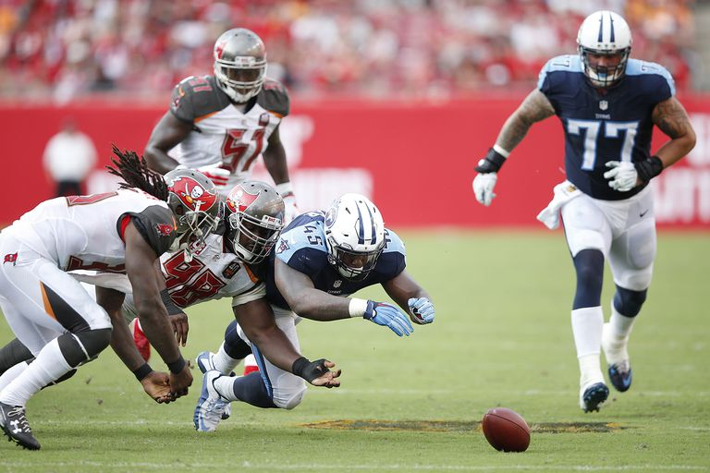
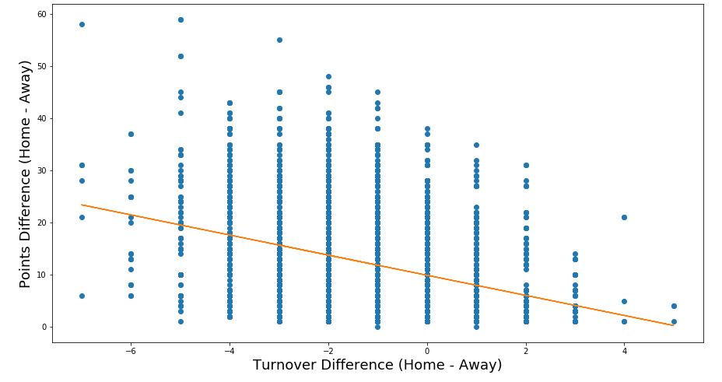
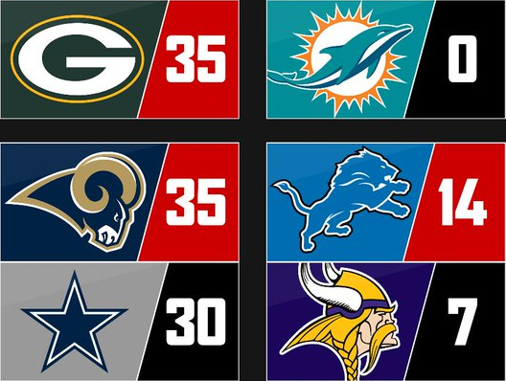
Points difference is larger on when away team has more turnovers
vs.

Slide 8
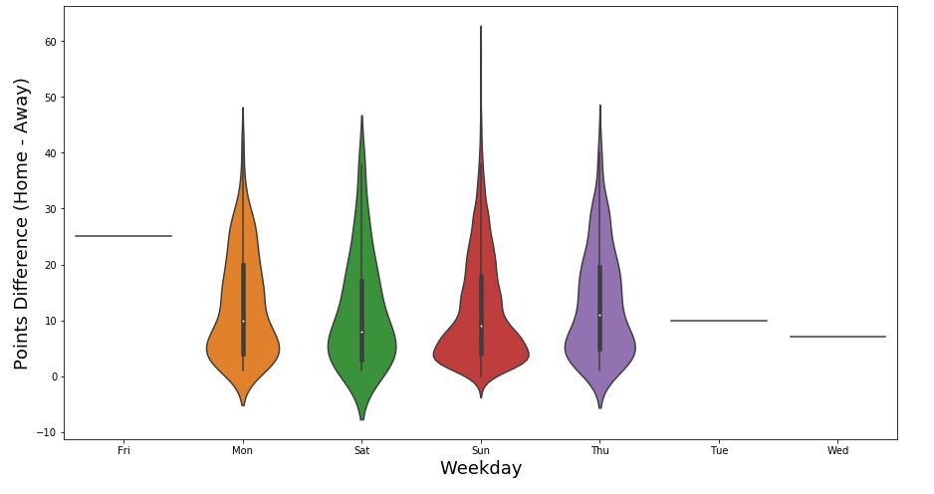
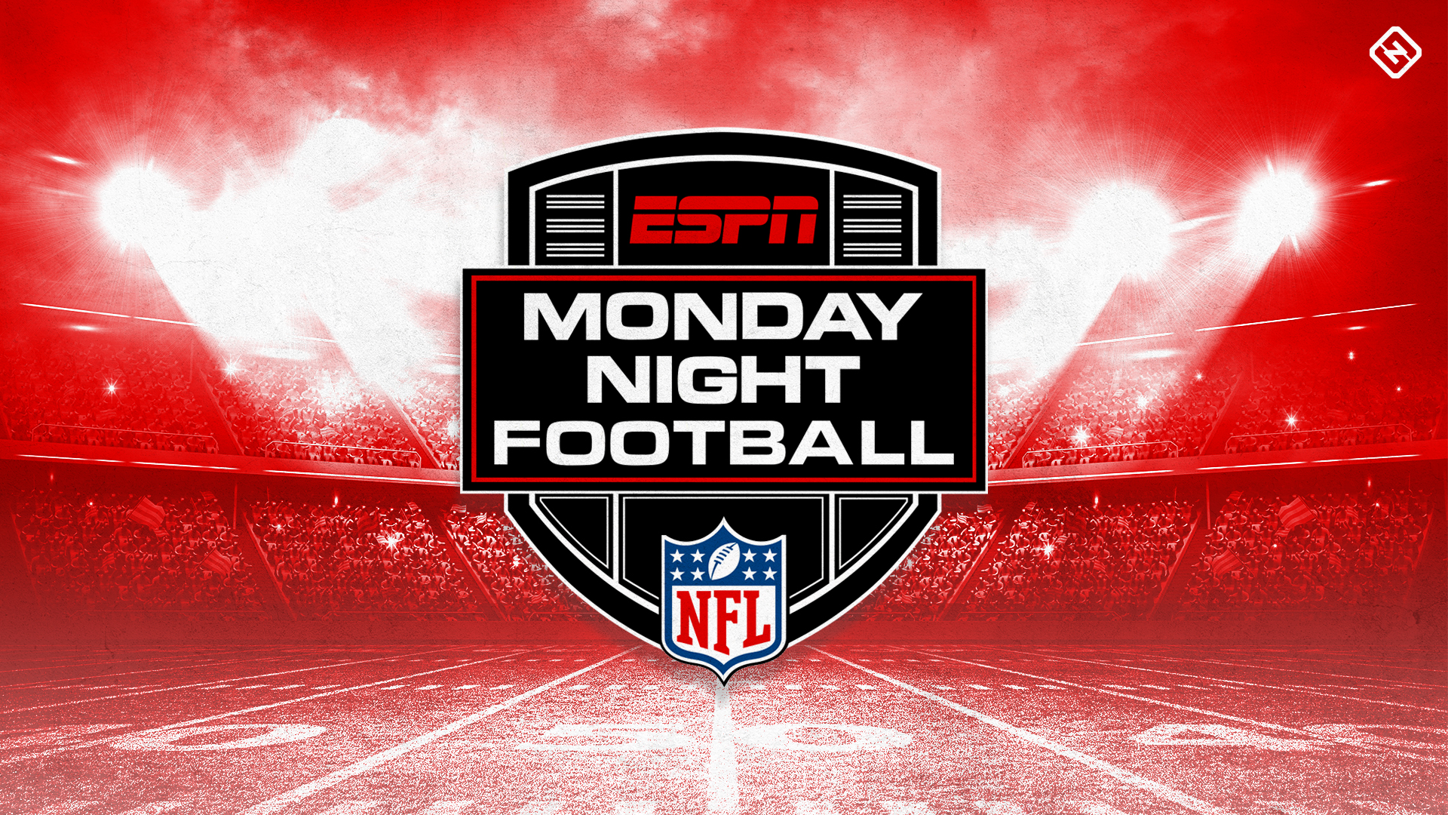
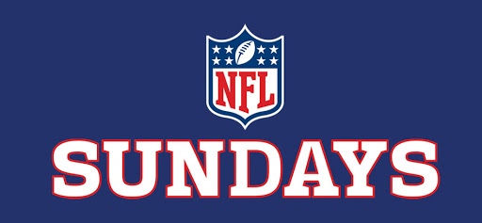
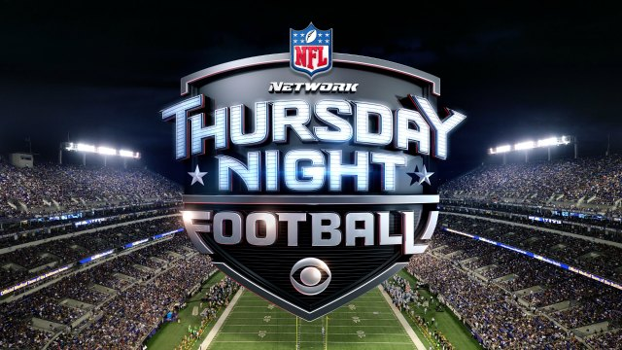
Points difference is larger on Sunday games

Slide 9
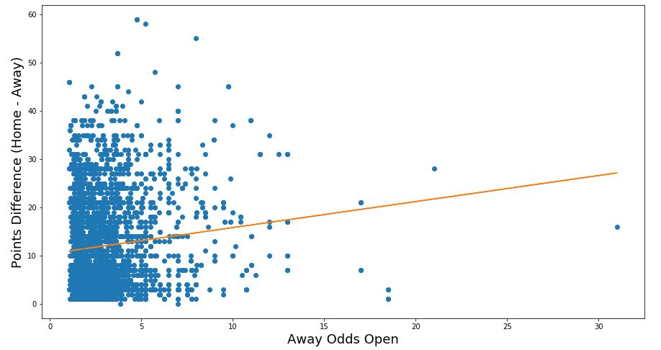
Points difference is larger when the odds are larger

Slide 10
Analysis Details
When the away team had more turnovers, there was a larger point difference (home score – away score)
The point difference was larger in Sunday games compared to Monday night or Thursday night games
The point difference was larger when the betting odds were higher

Slide 11
The stakeholders who would benefit from this research would people who are members of NFL fantasy leagues, and other betting leagues. Also employees of casinos and other betting places would benefit from this data.
It would give them insight into who would win a particular NFL game based on variables from previous games with the same teams.
The fantasy league members could increase their winnings, and casino employees could modify the odds in order to decrease the winnings of the people making bets.
This research is very interesting to me because I love NFL football, and I am currently a member of an NFL game betting pool.
Stakeholders

Slide 12
Point differences in NFL games are increased when the away team had more turnovers, therefore people should bet more money on teams that had fewer turnovers in the previous games.
The point difference was larger in Sunday games compared to Monday night or Thursday night games, therefore people should bet more money on Sunday games.
The point difference was larger when the betting odds were higher
Conclusions

Slide 13
Questions?

